Slide 1
Photocatalytic and photoelectrochemical carbon dioxide reduction (PhotoRed)
Urszula NARKIEWICZ
West Pomeranian University of Technology in Szczecin

Slide 2
Photocatalytic and photoelectrochemical carbon dioxide reduction (PhotoRed)
Project Promoter: West Pomeranian University of Technology in Szczecin
Project Partners:
University of South-Eastern Norway
SINTEF AS Industry
SINTEF AS Ocean
Duration of the project: 01.09.2020 – 31.08. 2023
Total project cost: 8 037 500 PLN
Project grant amount: 8 037 500 PLN

Slide 3
The aim of the project
Previous POLNOR project (2014-2017) of the same consortium – SolSorb
Result: carbon spheres determined as an excellent sorbent for CO₂ capture, enabling to adsorb above 6 mmol of CO₂/g/h at ambient conditions.
Recent project – a continuation aiming to transform CO₂ into useful products
Modification of carbon spheres to obtain new photocatalysts using additives as TiO₂ or ZnO
To convert at least 10 micromol of CO₂/g/h under UV at ambient conditions and to maintain the activity at the same level for at least 200 h.
Develop successful small-scale photo- and photoelectrical quartz glass reactors and use these as a basis for designing and fabricating large-scale (increased several times) and upgraded reactors made of stainless steel and quartz glass.
Conduct a 'safe by design' environmental assessment of the photocatalysts produced.
Increase social awareness of the CCS and CCU issues.

Slide 4
Research methodology/ research approach
the WPs relations is shown in the figure below.

Slide 5
Implemented tasks and research results achieved so far
More than 50 samples of photocatalysts produced and characterised
The laboratory set-up for photochemical and photoelectrochemical tests are ready
Two deliverables submitted on time (M6):
D.1.1. Report on the catalysts preparation procedures
D.2.1. Report on fundamental calculations
2 papers published (Opt. Mater., RAMS), 1 paper accepted for publication (Catalysis Today)
1 patent declared
2 conference presentations delivered (NanoTech Conference, 9-11 June 2021)
1 engineer thesis performed

Slide 6
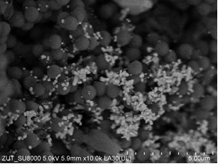
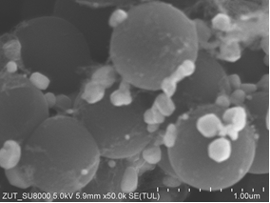
Implemented tasks and research results achieved so far
Carbon spheres before and after modification with ZnO

Slide 7
Implemented tasks and research results achieved so far
UV photoreactors in thermostatic chambers

Slide 8
Implemented tasks and research results achieved so far
DFT calculations

Slide 9
Planned project outcomes (long and short term)
Short term
Novel method that combines CO₂ capture with CO₂ utilisation using tailormade catalyst materials, advanced materials for CCU
Identification of potential hybrid catalyst materials for application in the capture and utilisation of CO₂ via photochemical and electrochemical processes
Laboratory methods and infrastructure for production and development of the materials - a key step towards commercialisation and moving the technology to higher readiness levels in the short term
New CCS/CCU proces, competitive in terms of cost, efficiency and environmental impacts relative to other approaches at more advanced technology readiness levels (e.g. amine-based CO₂ capture)
At least 100 samples of catalysts will be prepared and tested in photocatalytic and photoelectrochemical assessment
The produced catalysts will allow to convert at least 10 micromol of CO₂/g/h at ambient conditions under UV and to maintain the stable activity for at least 200 h
Mathematical modelling will be applied for materials selection and engineering optimisation enabling the technology development process to proceed more quickly.
Large-scale laboratory photochemical and electrochemical reactors will be designed and produced
Detailed environmental assessment of the new materials during the development stage, with the aim of identifying those materials which pose the least risk from a human health and environmental perspective
Dissemination of knowledge – publications and conferences
Involvement of MSc and PhD students

Slide 10
Planned project outcomes (long and short term)
Long-term
PhotoRed addresses 2 important issues:
climate change mitigation
depletion of energy resources
The long-term outcomes of the project are:
the capture technology will provide a new and competitive mechanism for reducing anthropogenic CO₂ emissions and therefore contribute towards the societal goal of decreasing the rate of climate change
contribution to closing the carbon cycle by providing novel approach for utilising captured CO₂ to produce valuable raw fuel materials and chemicals for other applications.
contribution to increasing the proportion of renewable energy used globally and reducing societal reliance on fossil fuels. CO₂ utilisation has the long term potential to produce simple hydrocarbon molecules not just for the energy and fuels sector, but as a raw material for many other industries
successful implementation of the PhotoRed project can lead to further projects in this field, specifically with a close collaboration with industry partners representing technology developers and large CO₂ emitters (e.g. power stations and industries producing large volumes of CO₂).
the ultimate outcome of the project would be to design a full developed catalyst-based capture and utilisation system that has been fully commercialised and in operation to reduce atmospheric CO₂ emissions from industrial and power plants.

Slide 11
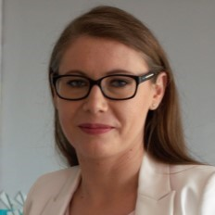
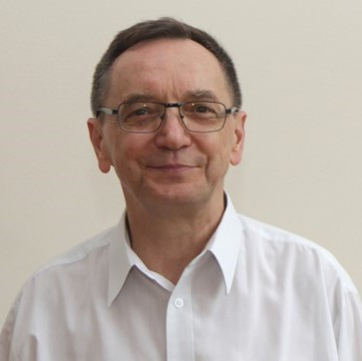
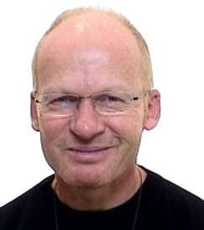
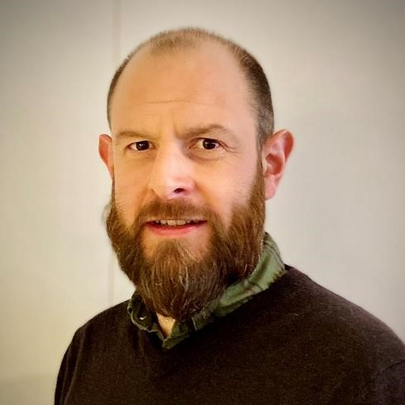
Acknowledgmenents to all project participants
Represented here by the liders of WPs
WP1
Iwona Pełech
WP2
Ewelina Kusiak-Nejman
WP3
Antoni Morawski
WP4
Kaiying Wang
WP5
Richard Blom
WP6
Andy Booth

Slide 12
Thank you!
Urszula.Narkiewicz@zut.edu.pl

